Slide 1
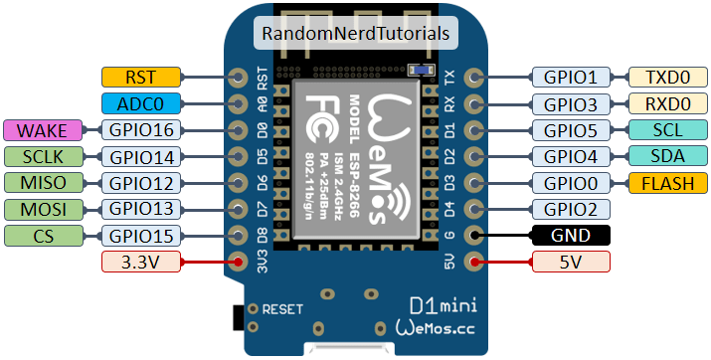
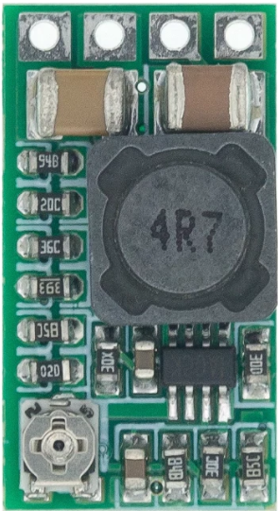
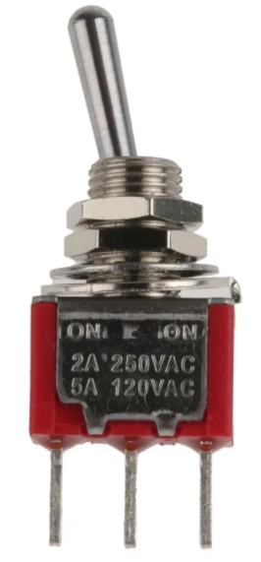
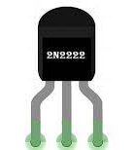
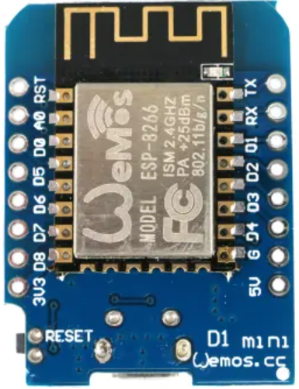
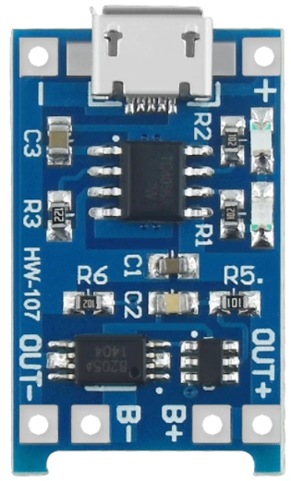
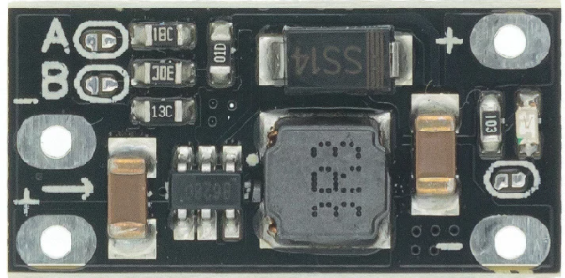
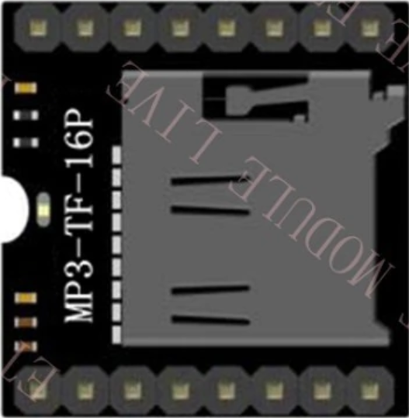
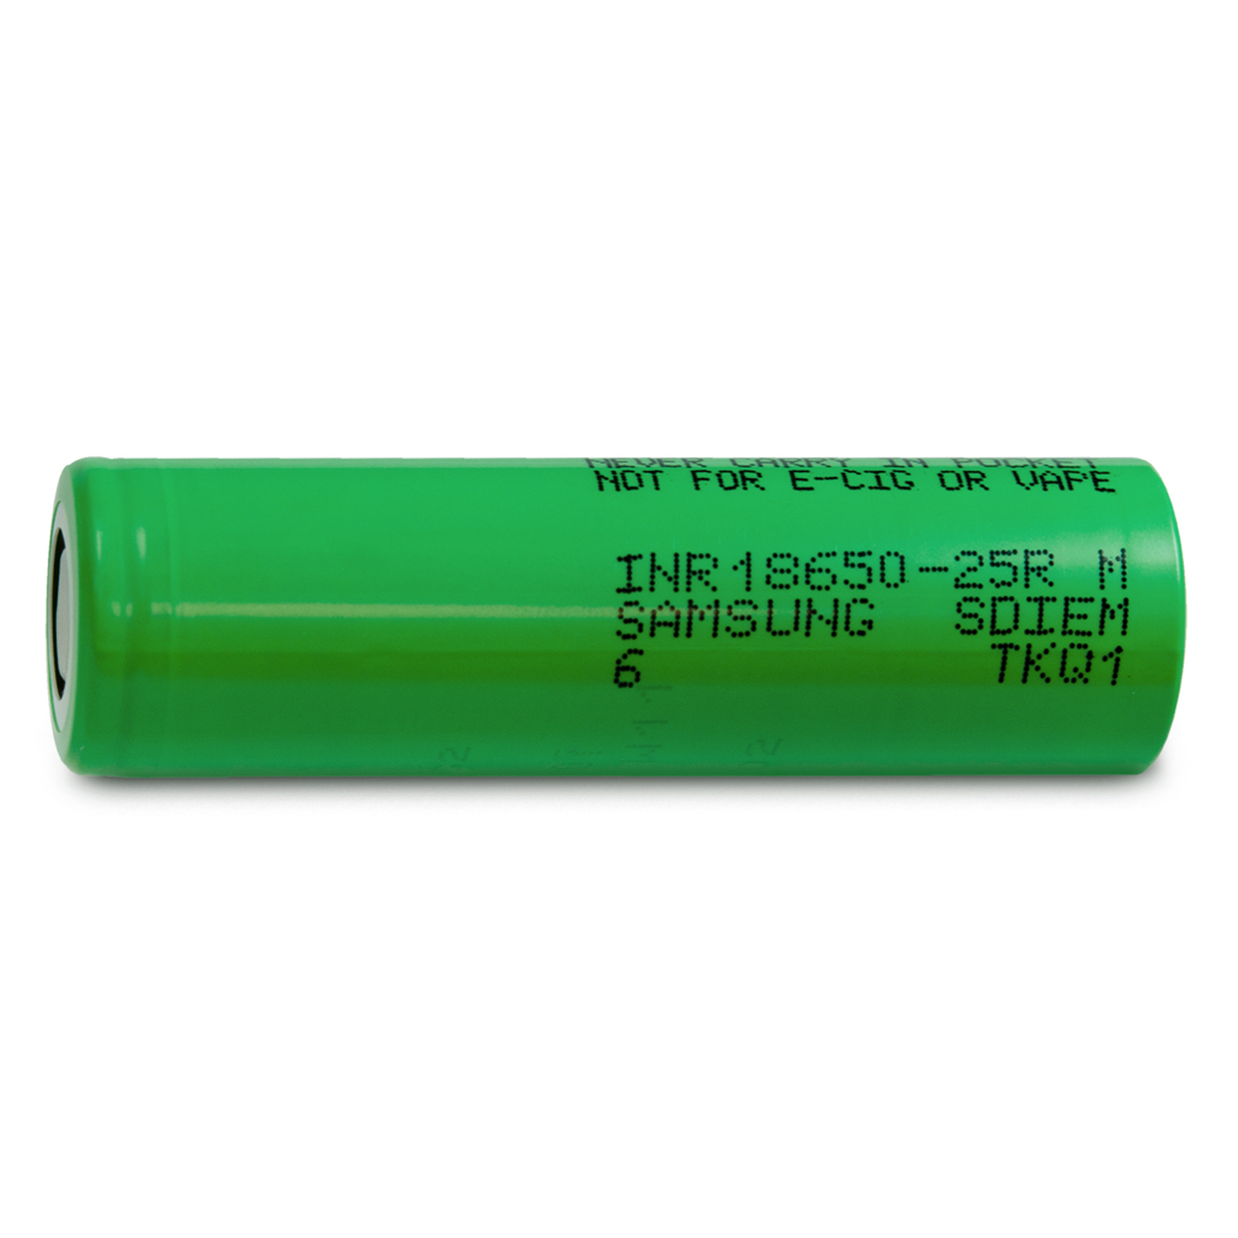
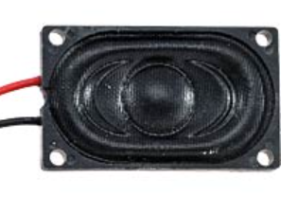
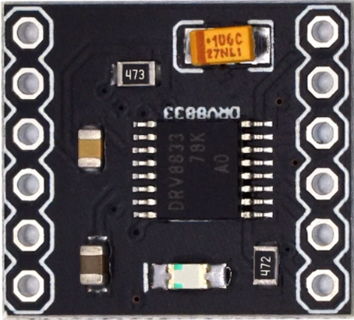
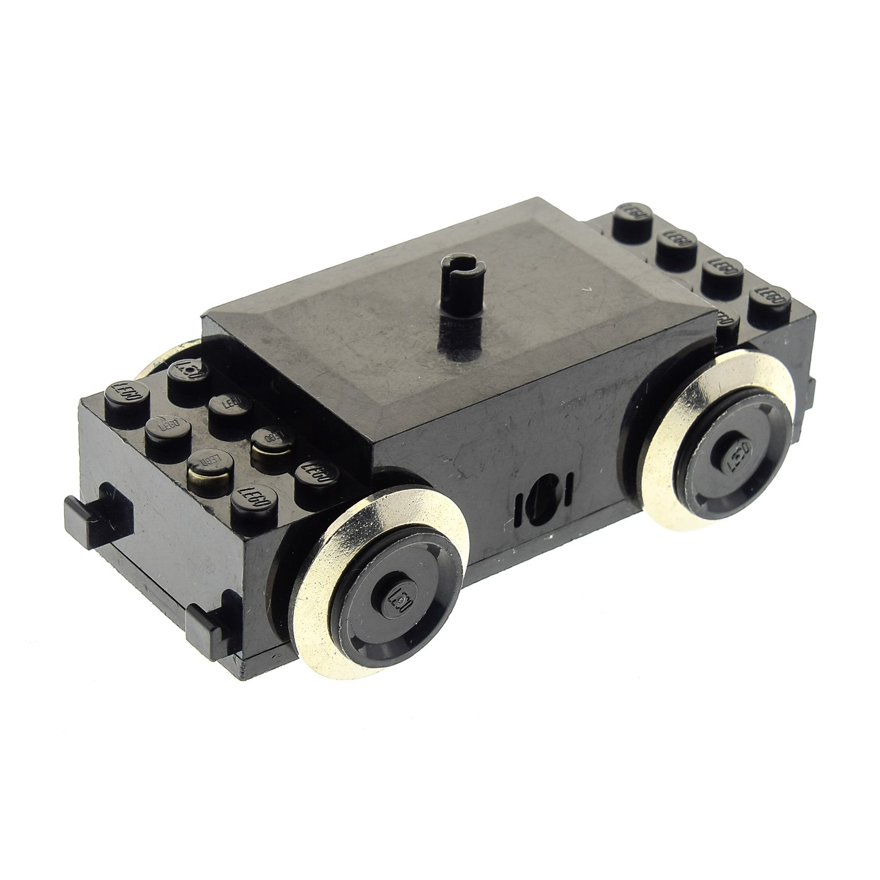
Controller
[ WEMOS D1 Mini ]
10K
Schalter
LED
180K
2.2K
BMS
[ TC4056 + Discharge Protection]
LED
2.2K
LED
Voltage Booster
[ Step-Up 5V Out ]
2.2K
Battery
[ 18650 Li-Ion Zelle ]
Motortreiber
[ DRV8833 H-Bridge ]

Slide 2
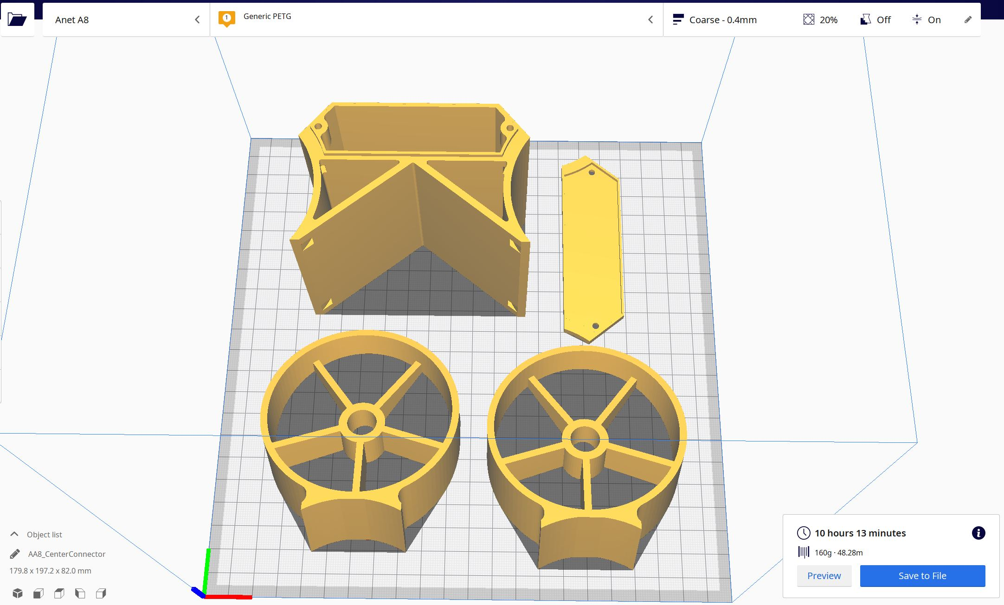
3D Druck

Slide 3
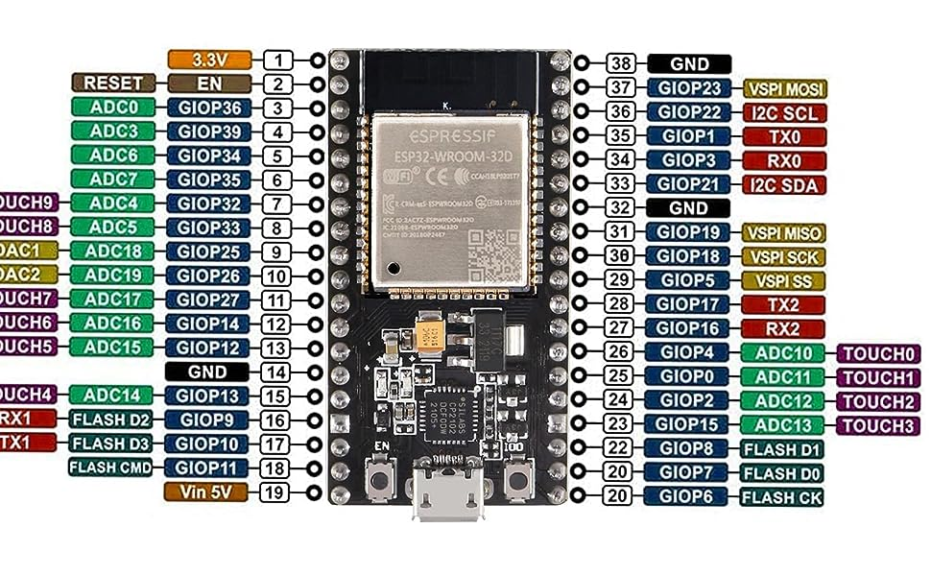

Slide 4
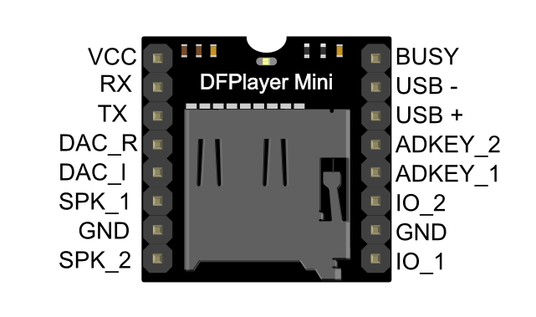

Slide 5
1x GND
1x GND
1x GND
2x I2C
2x I2C
2x I2C
10 Pin
1x Btn
1x Btn
M1, M2
3x LED
1x LED
Cap Sensors
3,3 V 5 V
3,3 V 5 V
Sound Module
3,3 V 5 V
LED
Shots Carriage
Christmas Carriage
Small Carriage
Locomotive
Controller
Motor Driver
Distance Sensor
Powerbank
Scanner
Motor

Slide 6
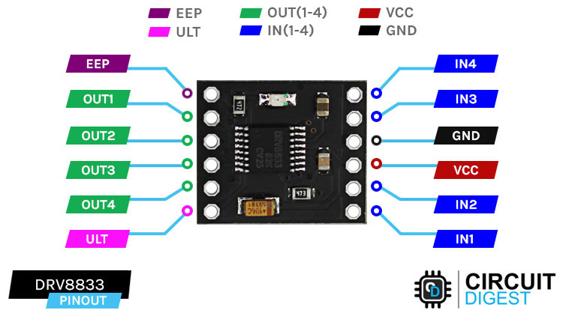
34-29 are input only
In Only
OK
PWM at boot
v
v

Slide 7
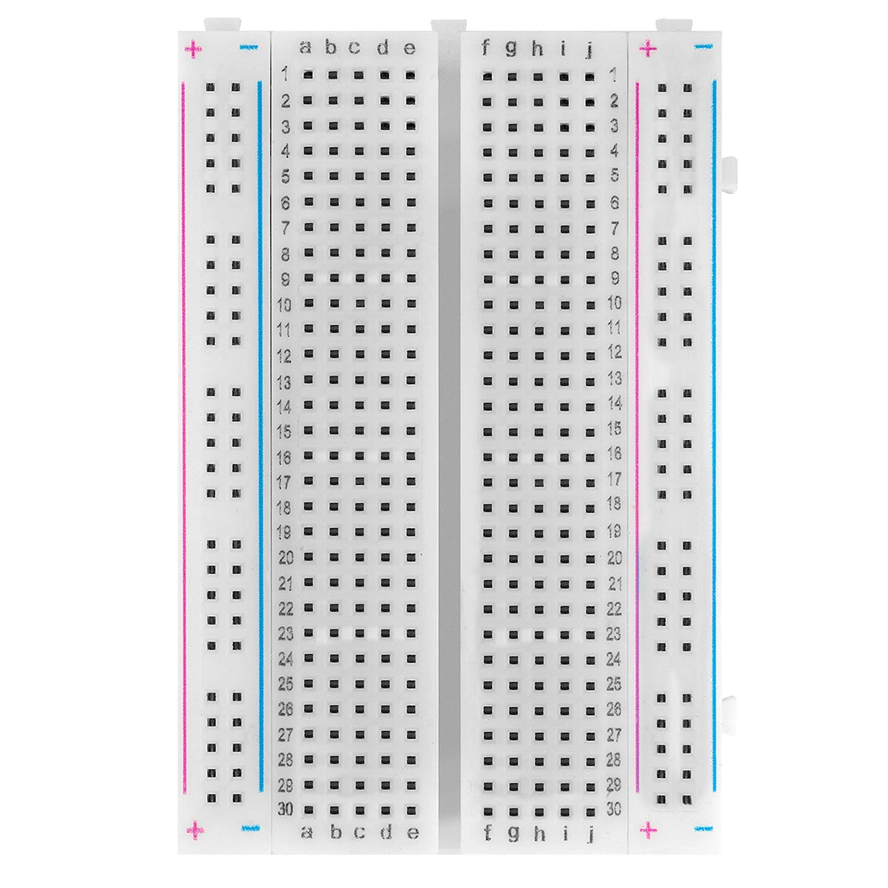
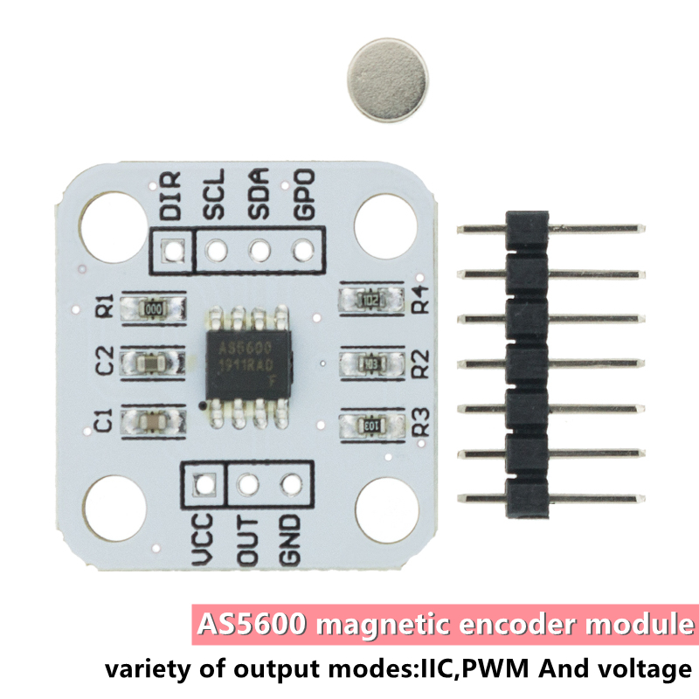
DIR
SCK
SDA
PGO
GND
VCC
SCK
SDA
SCL
SDA
DIR
SCK
SDA
PGO
POTI
LED

Slide 8
